Slide 1

Sauce & Spoon
Tablet Rollout
Impact Report

Slide 2
Executive Summary
The purpose of the tablet rollout is to improve the overall customer experience while optimizing our operations at the North and Downtown locations.. One of the significant factors we wanted to focus on was reducing the wait time for the customers to be seated and receive their food order. We achieved this goal by reducing overall wait time less than 30 minutes. Patrons were also impressed by our new digital initiative and 86% were satisfied with the tablet ordering process. In addition, our revenue increased by a whopping 20% since September while cutting our food waste in half. A couple lessons we learned from the rollout is to make sure the tablets themselves are properly functioning and ensure we have enough kitchen staff to fill orders.
With the success of this project, we are excited to move forward with expanding to the rest our locations. Along with the tablets, we also plan to implement more social and marketing integration.

Slide 3
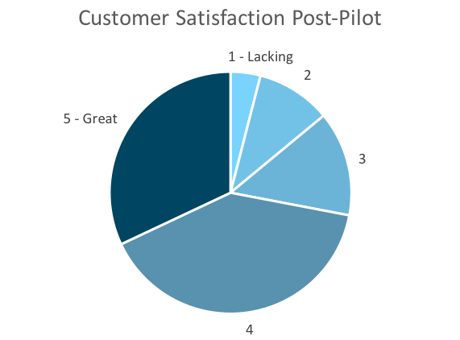
Customer Satisfaction: Pilot
Q. On a scale of 1-5, please rate your experience with the tablet overall.
This pie chart illustrates the results from the post-pilot survey.
72% of respondents indicated a customer satisfaction score of 4 or 5.
Notes:
First pie chart: Results from the post-pilot survey
Second pie chart: Results from the post-launch survey, after making changes
Satisfaction has gone up from 72% (4 and 5 rating) to 86% (4 and 5 rating)
Post-pilot data:
1 - Lacking 2 4%
2 5 10%
3 7 14%
4 20 40%
5 - Great 16 32%
Post-launch data:
1 - Lacking 1 2%
2 2 4%
3 4 8%
4 22 44%
5 - Great 21 42%

Slide 4
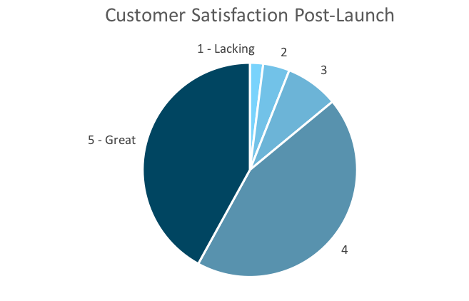
Customer Satisfaction: Launch
Q. On a scale of 1-5, please rate your experience with the tablet overall.
This pie chart illustrates the results from the post-launch survey.
86% of respondents indicated a customer satisfaction score of 4 or 5. This is a 14% increase.
Notes:
First pie chart: Results from the post-pilot survey
Second pie chart: Results from the post-launch survey, after making changes
Satisfaction has gone up from 72% (4 and 5 rating) to 86% (4 and 5 rating)
Post-pilot data:
1 - Lacking 2 4%
2 5 10%
3 7 14%
4 20 40%
5 - Great 16 32%
Post-launch data:
1 - Lacking 1 2%
2 2 4%
3 4 8%
4 22 44%
5 - Great 21 42%

Slide 5
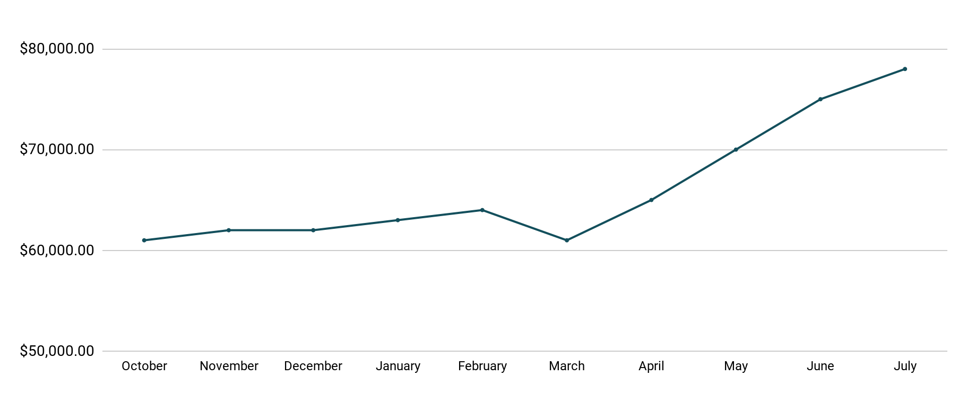
Revenue
Tablet Launch April 23
This is a chart of Sauce & Spoon revenue, showing that after tablet implementation, revenue increased.
July revenue was up to 20% over April’s monthly revenue.
Notes:
This is a chart of Sauce & Spoon revenue, showing that after tablet implementation, revenue increased. December revenue was up to 20% over September’s monthly revenue.
Sales data:
October
$61,000.00
November
$62,000.00
December
$62,000.00
January
$63,000.00
February
$64,000.00
March
$61,000.00
April
$65,000.00
May
$70,000.00
June
$75,000.00
July
$78,000.00

Slide 6
What Worked: Key Accomplishments
Decreased table turn time
Implementation of the tablets increased the average daily guest count by 10%.
Tablets also decreased wait time by 30 minutes.
Decreased food waste
Tablets identified who was receiving an incorrect order.
Kitchen staff has taken the initiative to correct orders and decrease food waste by 50%.
Increased customer satisfaction
After the pilot, customer satisfaction was at 72%.
Once we implemented improvements based on feedback, customer satisfaction increased to 86%.
Increased sales
Our monthly revenue has increased steadily since the tablet rollout, upwards of 20% since September/pre-rollout.
Tablets also helped boost revenue during the holiday season.

Slide 7
Next Steps: Looking Forward
Initiative | Action | Date
Implement tablets in more locations | Create new project plan for new location installation | Q2
Continue to track customer experience and satisfaction | Continue surveying/ gathering data through various means | Ongoing
Expand tablet features | Investigate new features like social media integration, reservations, videos, etc. | Q4

Slide 8
Appendix
Access all resources here.
Notes:
Insert link to your shared drive or a shared folder with all of the relevant project artifacts

